Slide 1
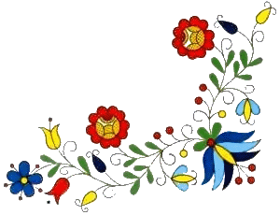
Polish Graphics
Workshops in Lithuania
Kaunas, 01.12.2014 – 05.12.2014

Slide 2
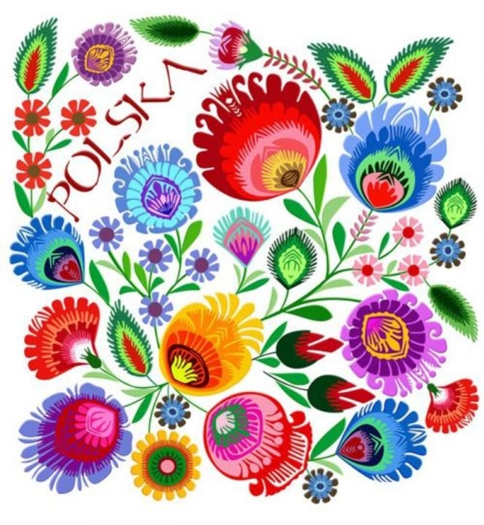
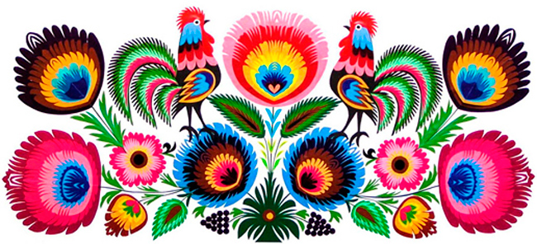
Łowicz’s collage
‘The Kodra’ – multicoloured collage on the
rectangular sheet of white paper
Features of the Łowicz’s design:
plant or animal motifs: cocks, the eye of a
peacock’s tail
colourful belts,
symmetry,

Slide 3
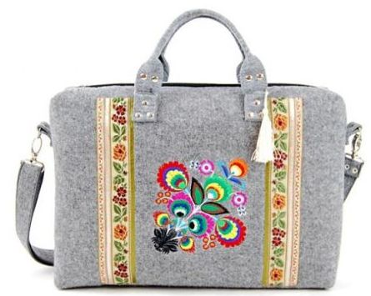
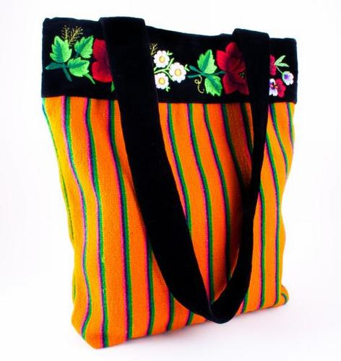
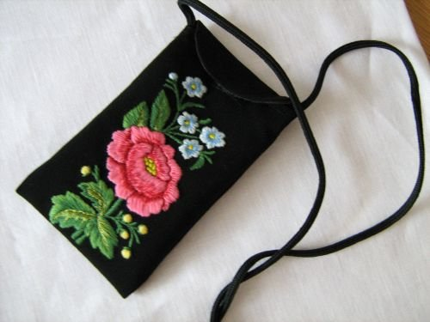
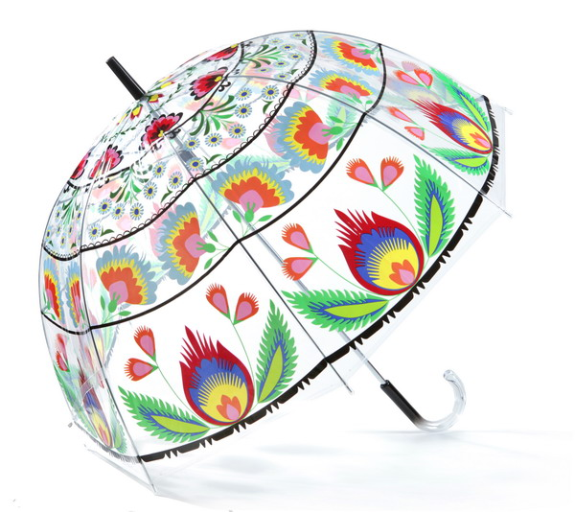
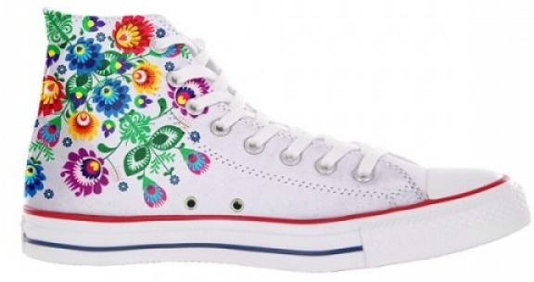
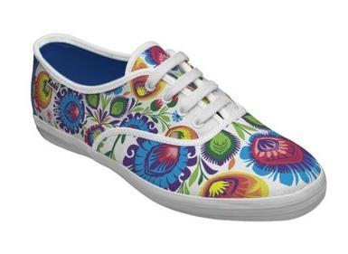
Łowicz’s design in the contemporary fashion

Slide 4
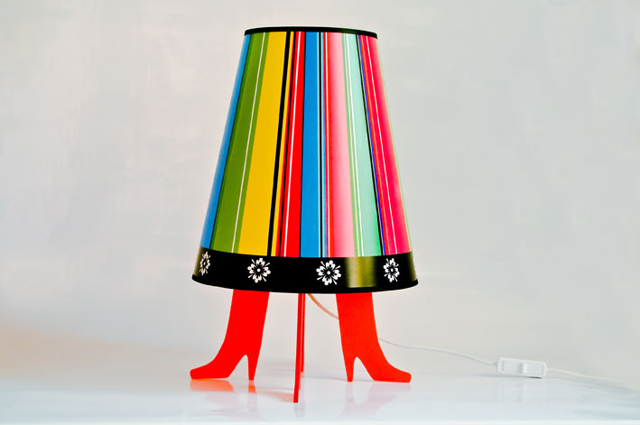
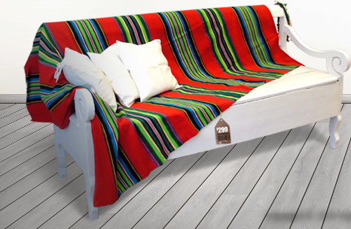
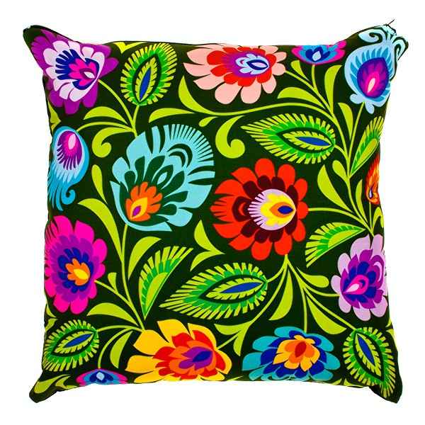
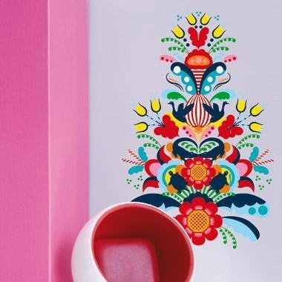
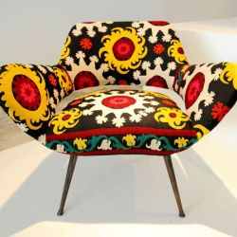
Łowicz’s design
– the architecture of interiors

Slide 5
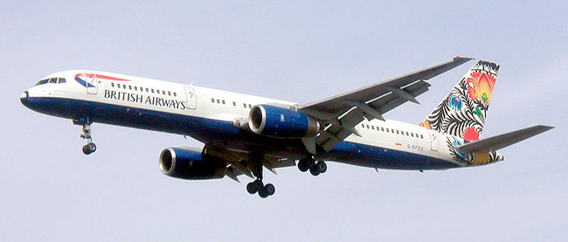
The Łowicz’s design at present
The fragment of the Łowicz’s star appeared on the tail of the plane large British Airways airline. The campaign established putting the line on planes, colourful ethnic patterns from countries to which the company is leading air links. In spite of the striking appearance, the campaign met reluctantly on the part of British people who acknowledged that the concern had lost its British identity into this way.

Slide 6
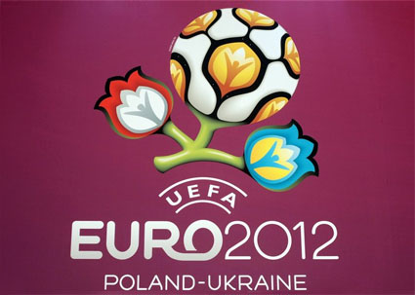
Łowicz’s design
– the logo EURO 2012 in Poland

Slide 7
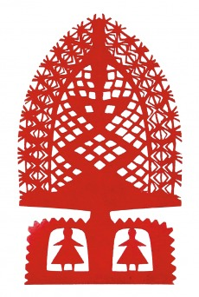

Cut-outs of the Kurpie and Podkarpacie’s region
‘The Leluja’
monochromatic or
colourful cut-out in the
form trees leaving
from the vase,
vertical composition,
motifs animal: cocks,
peacocks,
plant motifs,
- people’ figures,
- symmetry.

Slide 8
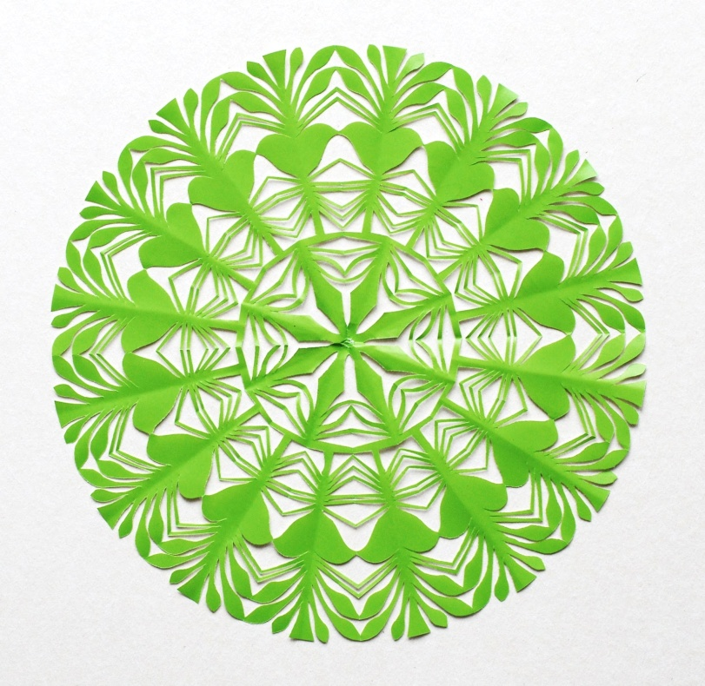
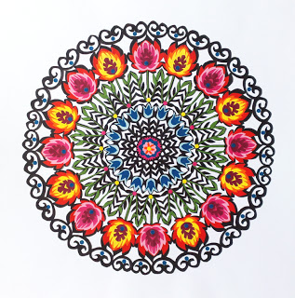
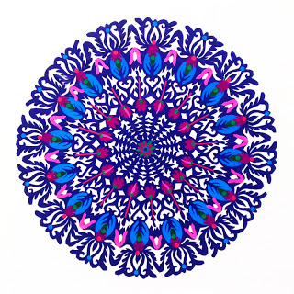
Cut-outs of the Kurpie’s region
‘The Star’
a shape of the wheel,
one or two colours cut –out,
motifs walk off a stiffness as rays, from the centre.

Slide 9
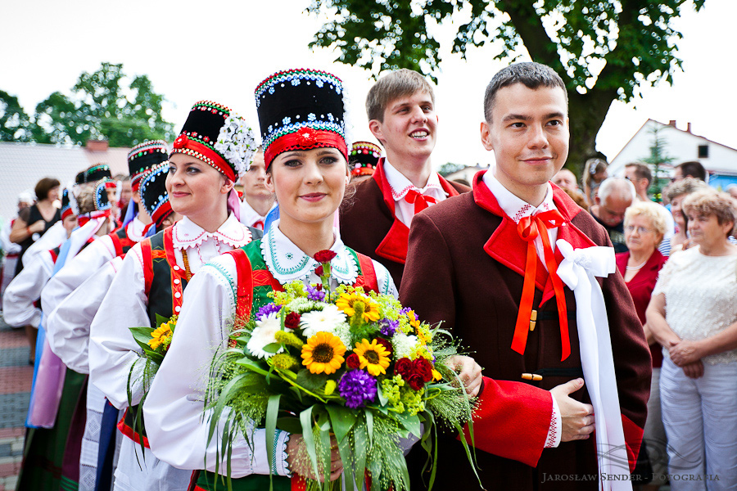
The wedding ceremony – Kurpie’s region

Slide 10
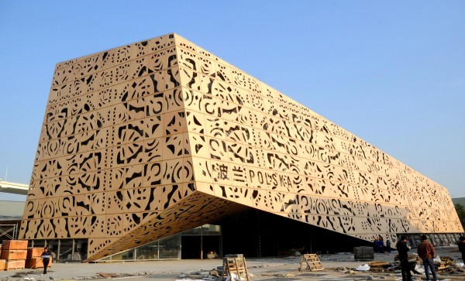
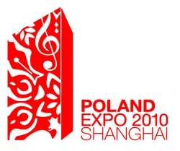
Kurpie’s design in the contemporary architecture
Architects designed the logo and the elevation of the building of the Polish pavilion to the EXPO 2010 fair into Shanghai, using the motifs for the Polish cut-out. Then, Poland received a prestigious award in the category:
‘The Best Promotion of the Country’

Slide 11
Kashubian’s design
a composition with exploiting five basic colours:
blue, black, red, yellow, green,
flower motifs: cornflowers, roses, pansies,
bells, carnations, tulips, clover,
- insects: bees, beetles,
- the tree as the symbol of the life.

Slide 12

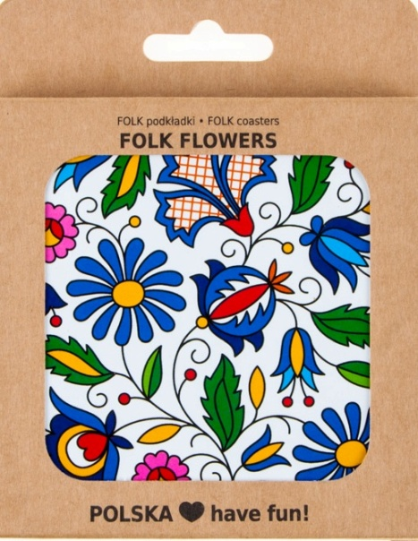
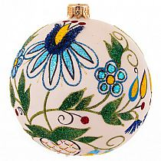
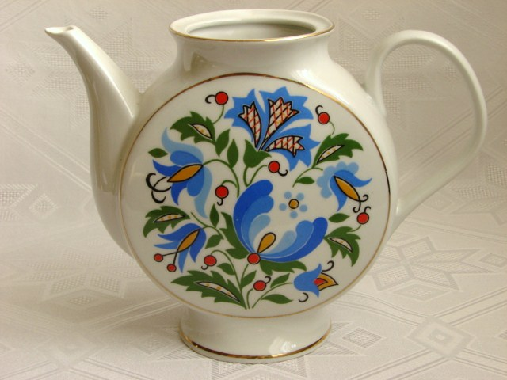
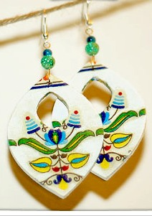
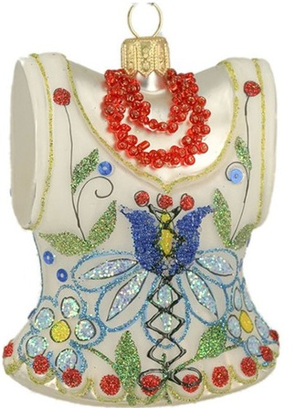
Kashubian’s design
Christmas bauble
to the Christmas tree
Kashubian embroidery
The pad of glasses
The jug with the Kashubian’s design
Earrings
Kashubian’s corset

Slide 13
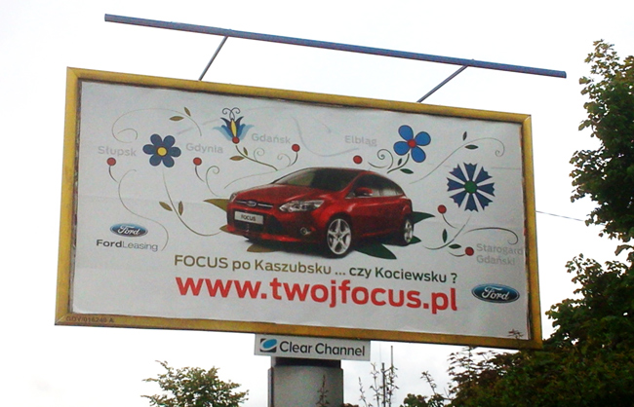
Kashubian’s design in the advertisement

Slide 14
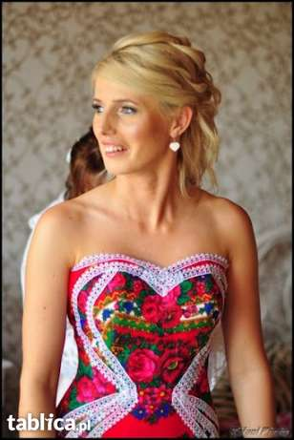
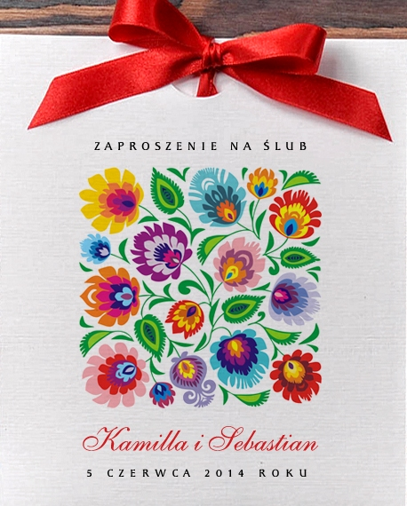
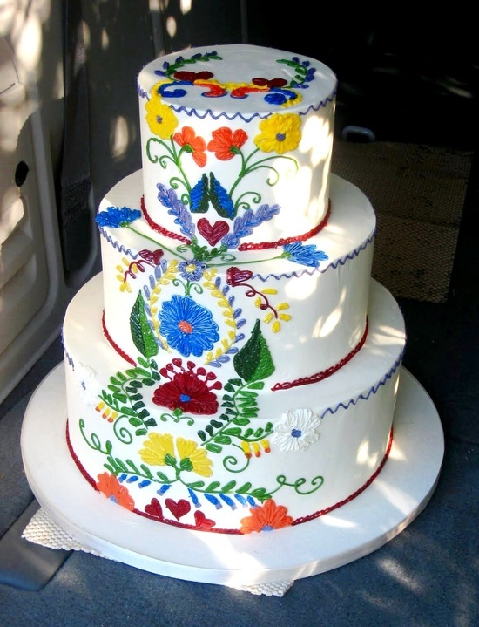
Kashubian’s wedding
the wedding invitation
the wedding cake
Kashubian’s bride

Slide 15
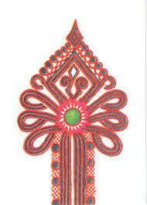
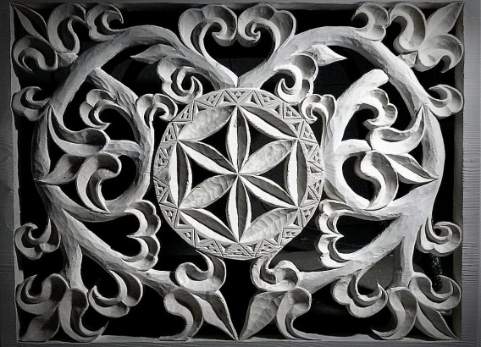
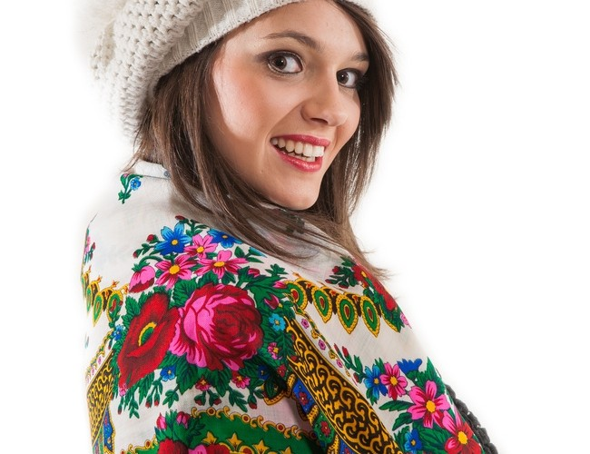
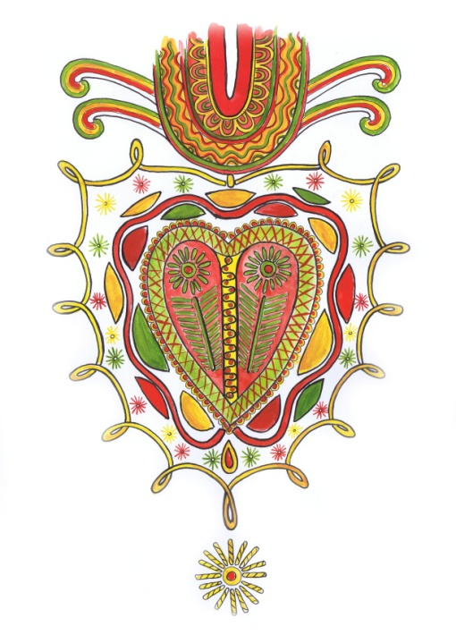
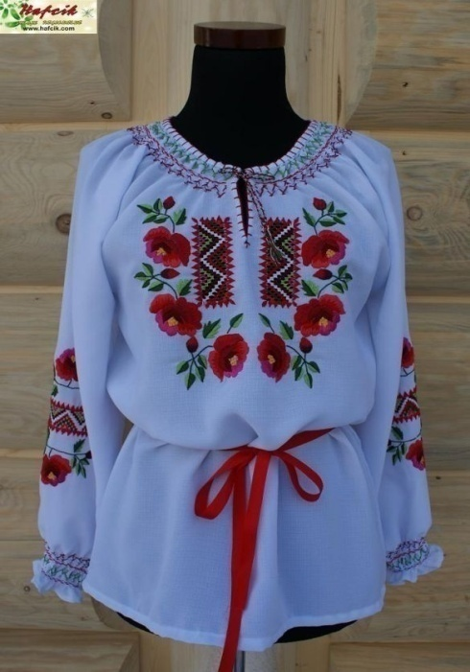
Highland’s design
flower motifs,
parzenica – pattern in the
shape of a heart,
star in the circle

Slide 16
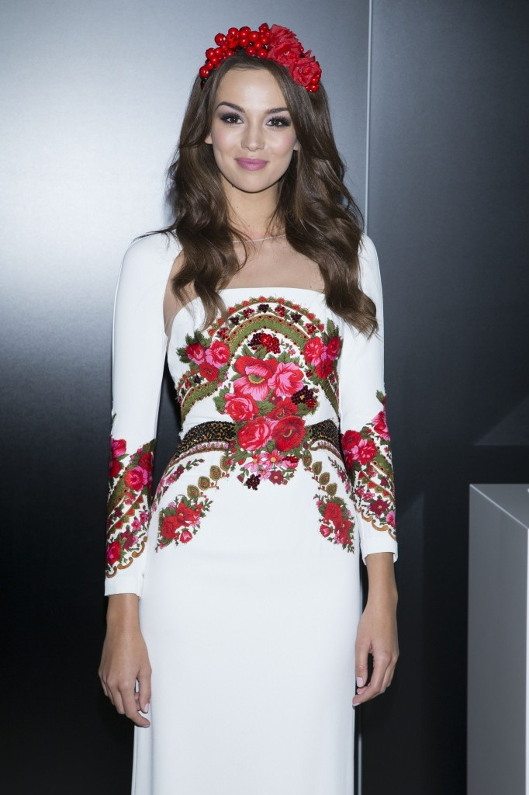
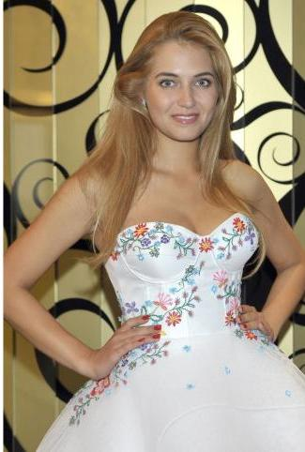
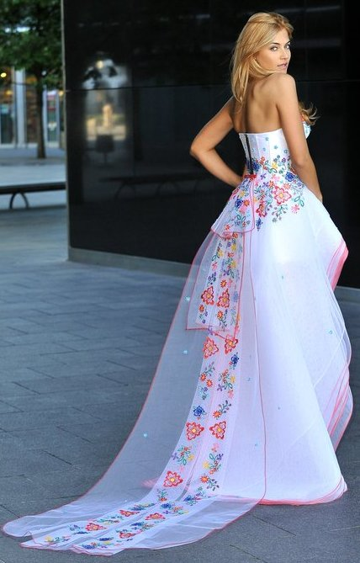
Fashion – highland’s motifs
Paulina Krupińska
– Miss Polonia 2012
Rozalia Mancewicz – Miss Polonia 2010

Slide 17
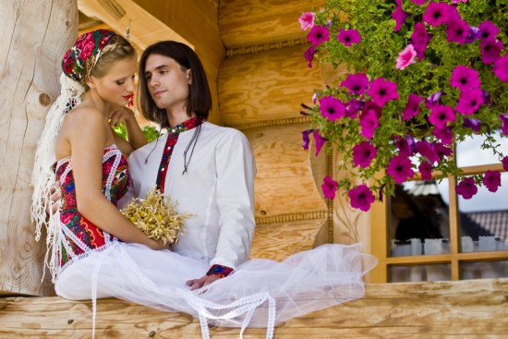
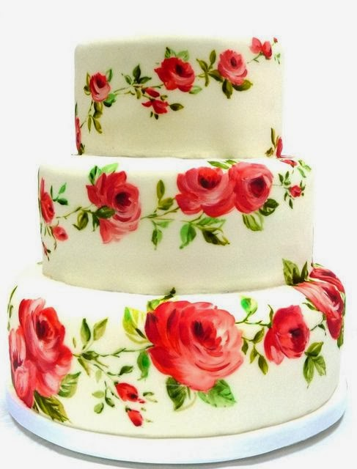
Highland’s wedding
the wedding cake
Young couples

Slide 18

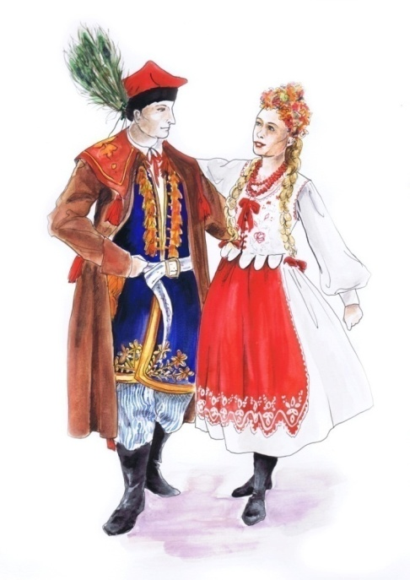
We thank you for attention
The multimedia presentation was drawn up through
Polish school - Publiczne Gimnazjum in Czarna

